Slide 1
PHYS 111 Experiment 1
Fall 2020
Foundation Physics Team

Slide 2
Objectives of Experiment 1
Take a series of measurements using various measuring tools
Estimate the Random Error for Individual Measurements
Estimate the Random Error for Computed Quantities
Determine Sources of random and Systematic Errors
Notes:
Objectives

Slide 3
Fine Measurements
There is a limit to the accuracy and precision of any measurement.
Two types of errors may affect the measurements:
Random error
Systematic error
Notes:
We can use the second bullet point to initiate a discussion amongst the students: Can an instrument reduce systematic error? If so, in what cases? Can an instrument reduce random error? If so, when and how?

Slide 4
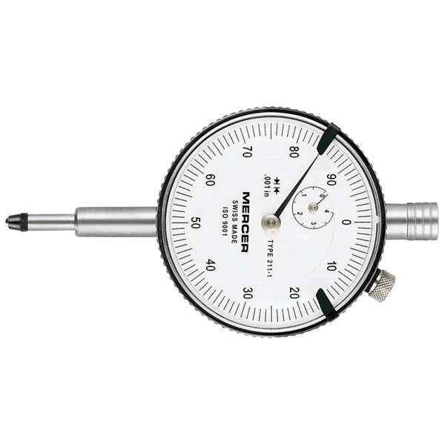
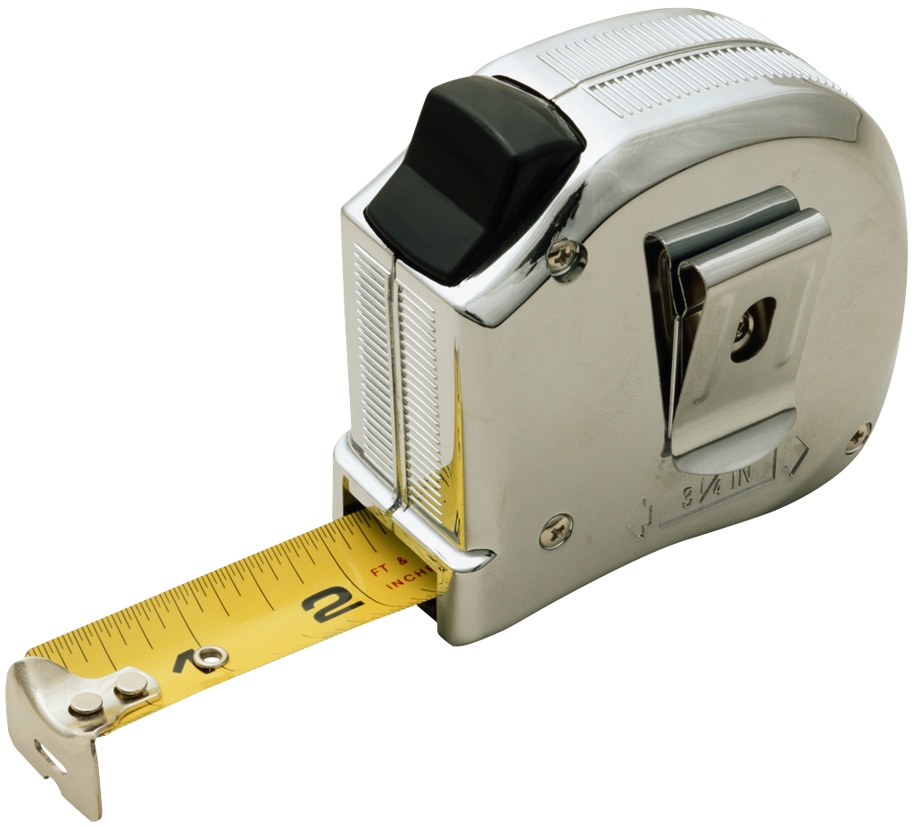
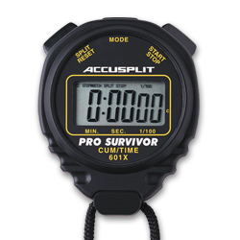
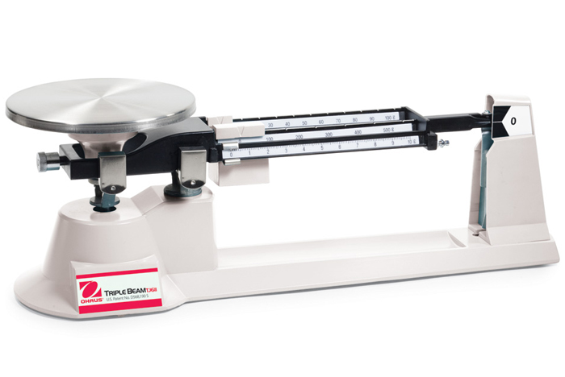
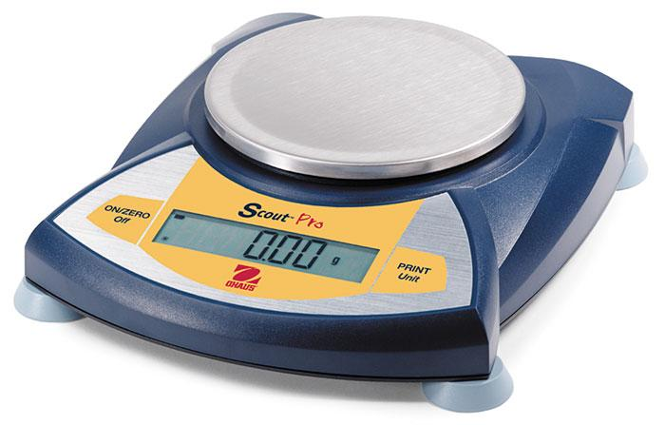
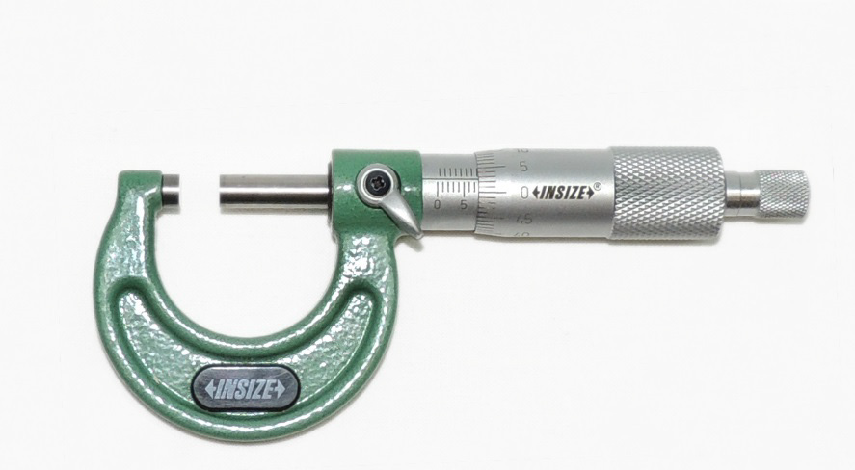
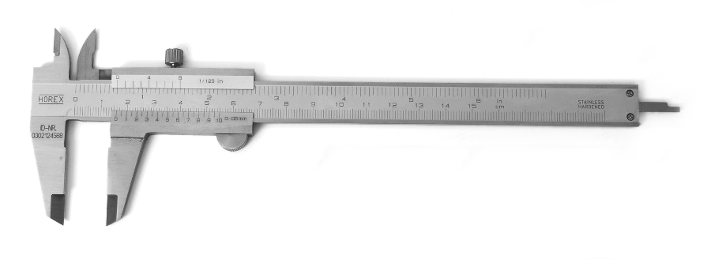
Many Tools are used in our lab for Measurements
Measuring Tape Timer/stopwatch Dial Gauge
Balances
Vernier Caliper Micrometer

Slide 5
Useful links:
Vernier Caliper
https://www.stefanelli.eng.br/en/virtual-vernier-caliper-simulator-05-millimeter/
Micrometer
https://www.stefanelli.eng.br/en/use-reading-micrometer-hundredth-millimeter/
Dial Gauge
https://www.stefanelli.eng.br/en/virtual-dial-indicator-simulator-hundredths-millimeter/

Slide 6
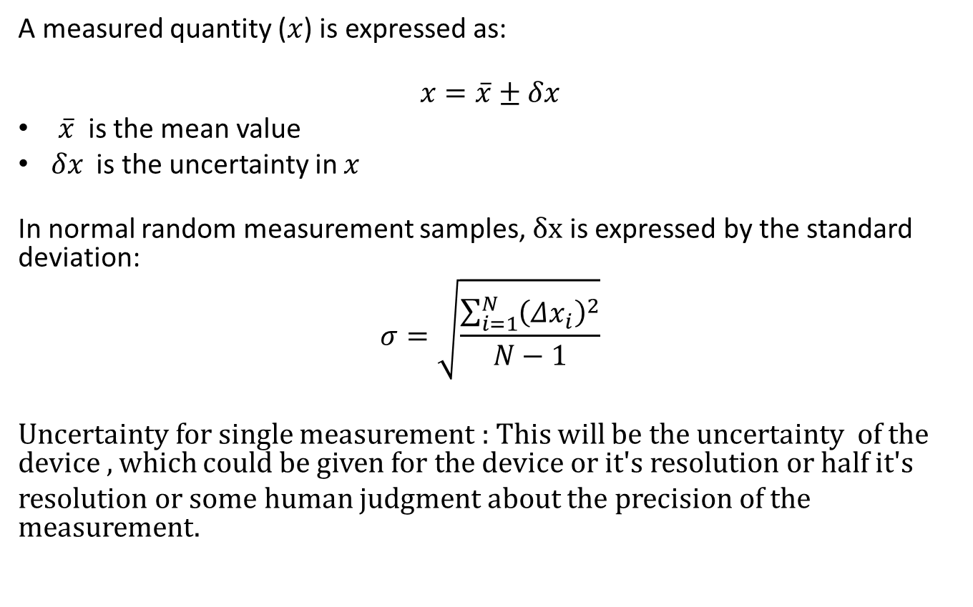
Uncertainty in measurements

Slide 7
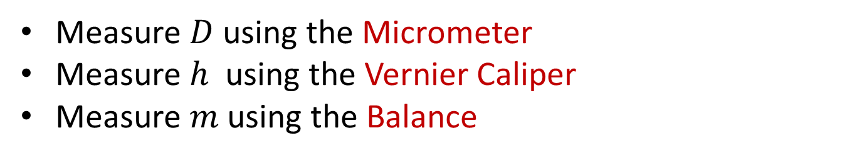



Example : Density of a steel Cylinder
Notes:
Copied from the text, but we need to say that the density is the average measurement, computed using the averages of the measured quantities.

Slide 8
Objectives of Experiment 1
Take a series of measurements using various measuring tools
Estimate the Random Error for Individual Measurements
Estimate the Random Error for Computed Quantities
Determine Sources of random and Systematic Errors
Notes:
Objectives

